Slide 1
Distributed Coordination
Dr. Muazzam A. Khan

Slide 2
Chapter 18 Distributed Coordination
Event Ordering
Mutual Exclusion
Atomicity
Concurrency Control
Deadlock Handling
Election Algorithms
Reaching Agreement

Slide 3
Chapter Objectives
To describe various methods for achieving mutual exclusion in a distributed system
To explain how atomic transactions can be implemented in a distributed system
To show how some of the concurrency-control schemes discussed in Chapter 6 can be modified for use in a distributed environment
To present schemes for handling deadlock prevention, deadlock avoidance, and deadlock detection in a distributed system

Slide 4
Event Ordering
Coordination of requests (especially in a fair way) requires events (requests) to be ordered.
Stand-alone systems:
Shared Clock / Memory
Use a time-stamp to determine ordering
Distributed Systems
No global clock
Each clock runs at different speeds
How do we order events running on physically separated systems?
Messages (the only mechanism for communicating between systems) can only be received after they have been sent.

Slide 5
Event Ordering
Happened-before relation (denoted by →)
If A and B are events in the same process, and A was executed before B, then A → B
If A is the event of sending a message by one process and B is the event of receiving that message by another process, then A → B
If A → B and B → C then A → C

Slide 6
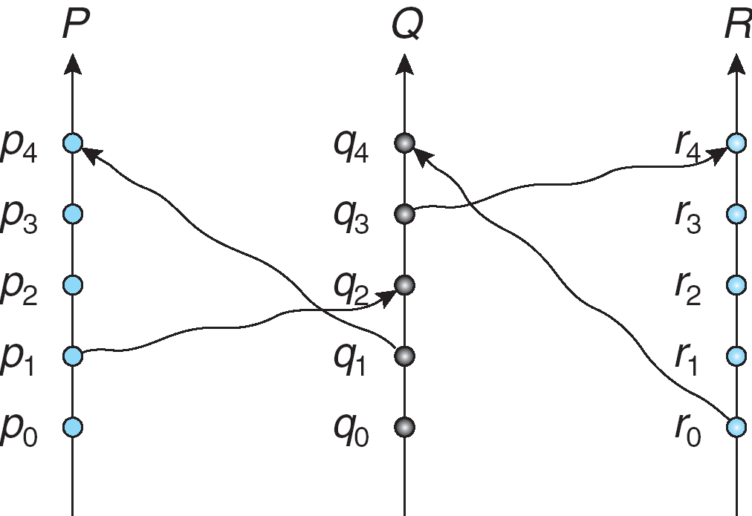
Relative Time for Three Concurrent Processes
Event Ordering
Time

Slide 7
Implementation of →
Associate a timestamp with each system event
Require that for every pair of events A and B, if A → B, then the timestamp of A is less than the timestamp of B
Within each process Pi a logical clock, LCi is associated
The logical clock can be implemented as a simple counter that is incremented between any two successive events executed within a process
Logical clock is monotonically increasing

Slide 8
Implementation of →
A process advances its logical clock when it receives a message whose timestamp is greater than the current value of its logical clock
If the timestamps of two events A and B are the same, then the events are concurrent
We may use the process identity numbers to break ties and to create a total ordering

Slide 9
Happened Before and Total Event Ordering
Define a notion of event ordering such that:
If A → B, then A precedes B.
If A and B are concurrent events, then nothing can be said about the ordering of A and B.
Solution:
Each processor i maintains a logical clock LC_{i}
When an event occurs locally, ++ LC_{i}
When processor X sends a message to Y, it also sends LC_{x} in the message.
When Y receives this message, it: if LC_{y} < (LC_{x} + 1) OR LC_{y} = LC_{x} + 1;
Note: If “time” of A precedes “time” of B, then ???

Slide 10
Distributed Mutual Exclusion (DME)
Assumptions
The system consists of n processes; each process P_{i} resides at a different processor
Each process has a critical section that requires mutual exclusion
Requirement
If P_{i} is executing in its critical section, then no other process P_{j} is executing in its critical section
We present two algorithms to ensure the mutual exclusion execution of processes in their critical sections

Slide 11
DME: Centralized Approach
One of the processes in the system is chosen to coordinate the entry to the critical section
A process that wants to enter its critical section sends a request message to the coordinator
The coordinator decides which process can enter the critical section next, and its sends that process a reply message
When the process receives a reply message from the coordinator, it enters its critical section
After exiting its critical section, the process sends a release message to the coordinator and proceeds with its execution
This scheme requires three messages per critical-section entry:
request
reply
release

Slide 12
Example: Centralized Approach
P1
Coordinator
P2
request
request
reply
Critical Section
reply
release
Critical Section
release
Advantages?
Disadvantages?
Notes:
Advantages:
Only 3 messages/CS
Only need to know who the coordinator is (not all participants)
Disadvantages:
Coordinator can become bottleneck.

Slide 13
DME: Fully Distributed Approach
When process P_{i} wants to enter its critical section, it generates a new timestamp, TS, and sends the message request (P_{i}, TS) to all other processes in the system
When process P_{j} receives a request message, it may reply immediately or it may defer sending a reply back
When process P_{i} receives a reply message from all other processes in the system, it can enter its critical section
After exiting its critical section, the process sends reply messages to all its deferred requests

Slide 14
Example – Decentralized Approach
P1
P2
P3
request (1)
request (2)
reply
reply
reply
Critical Section
reply
Critical Section
Advantages?
Disadvantages?
Lost reply hangs entire system
Notes:
Advantages:
Don’t need a server
Disadvantages
2 * (n-1) messages
Must know all cooperating processes
If set of processes change, hard to coordinate.

Slide 15
DME: Fully Distributed Approach (Cont.)
The decision whether process P_{j} replies immediately to a request (P_{i}, TS) message or defers its reply is based on three factors:
If P_{j} is in its critical section, then it defers its reply to P_{i}
If P_{j} does not want to enter its critical section, then it sends a reply immediately to P_{i}
If P_{j} wants to enter its critical section but has not yet entered it, then it compares its own request timestamp with the timestamp TS
If its own request timestamp is greater than TS, then it sends a reply immediately to P_{i} (P_{i} asked first)
Otherwise, the reply is deferred

Slide 16
Generals coordinate with link failures
Problem:
Two generals are on two separate mountains
Can communicate only via messengers; but messengers can get lost or captured by enemy
Goal is to coordinate their attack
If attack at different times → they loose !
If attack at the same time → they win !
A
B
Even if all previous
messages get through,
the generals still can’t
coordinate their actions,
since the last message
could be lost, always requiring
another confirmation
message.
Is 11AM OK?
11AM sounds good!
11AM it is, then.
Does A know that
this message was
delivered?

Slide 17
Desirable Behavior of Fully Distributed Approach
Freedom from Deadlock is ensured
Freedom from starvation is ensured, since entry to the critical section is scheduled according to the timestamp ordering
The timestamp ordering ensures that processes are served in a first-come, first served order
The number of messages per critical-section entry is 2 x (n – 1) This is the minimum number of required messages per critical-section entry when processes act independently and concurrently

Slide 18
Three Undesirable Consequences
The processes need to know the identity of all other processes in the system, which makes the dynamic addition and removal of processes more complex
If one of the processes fails, then the entire scheme collapses
This can be dealt with by continuously monitoring the state of all the processes in the system
Processes that have not entered their critical section must pause frequently to assure other processes that they intend to enter the critical section
This protocol is therefore suited for small, stable sets of cooperating processes

Slide 19
Token-Passing Approach
Circulate a token among processes in system
Token is special type of message
Possession of token entitles holder to enter critical section
Processes logically organized in a ring structure
Unidirectional ring guarantees freedom from starvation
Two types of failures
Lost token
Failed processes
Ring breaks

Slide 20
Token Passing
P1
c.s
P0
c.s
P2
c.s
token
When a process has the token, it can enter its critical section (if it wants to), or pass it on.

Slide 21
Atomicity
Either all the operations associated with a program unit are executed to completion.
Ensuring atomicity in a distributed system requires a transaction coordinator, which is responsible for the following:
Starting the execution of the transaction
Breaking the transaction into a number of sub-transactions, and distribution of these sub-transactions to the appropriate sites for execution
Coordinating the termination of the transaction, which may result in the transaction being committed at all sites or aborted at all sites

Slide 22
Distributed Transactions -- The Problem
How can we atomically update state on two different systems?
Generalization of the problem we discussed earlier !
Examples:
Atomically move a file from server A to server B
Atomically move $100 from one bank to another
Issues:
Messages exchanged by systems can be lost
Systems can crash
Use messages and retries over an unreliable network to synchronize the actions of two machines?
The two-phase commit protocol allows coordination under reasonable operating conditions.

Slide 23
Two-Phase Commit Protocol (2PC)
Assumes fail-stop model
Execution of the protocol is initiated by the coordinator after the last step of the transaction has been reached
When the protocol is initiated, the transaction may still be executing at some of the local sites
The protocol involves all the local sites at which the transaction executed
Example: Let T be a transaction initiated at site S_{i} and let the transaction coordinator at S_{i} be C_{i}
Notes:
https://shekhargulati.com/2018/09/05/two-phase-commit-protocol/

Slide 24
Phase 1: Obtaining a Decision
C_{i} adds <prepare T> record to the log
C_{i} sends <prepare T> message to all sites
When a site receives a <prepare T> message, the transaction manager determines if it can commit the transaction
If no: add <no T> record to the log and respond to C_{i} with <abort T>
If yes:
add <ready T> record to the log
send <ready T> message to C_{i}

Slide 25
Phase 1 (Cont.)
Coordinator collects responses
All respond “ready”, decision is commit
At least one response is “abort”, decision is abort
At least one participant fails to respond within time out period, decision is abort

Slide 26
Phase 2: Recording Decision in the Database
Coordinator adds a decision record
<abort T> or <commit T>
to its log and forces record onto stable storage
Coordinator sends a message to each participant informing it of the decision (commit or abort)
Participants take appropriate action.

Slide 27
Failure Handling in 2PC – Site Failure
If a site fails and than recover we need to check the log file for next decision
The log contains a <commit T> record
In this case, the site executes redo(T)
The log contains an <abort T> record
In this case, the site executes undo(T)
The log contains a <ready T> record; consult C_{i}
If C_{i} is down, site sends query-status T message to the other sites
The log contains no control records concerning T
In this case, the C_{i} must have aborted (T) and the Site executes undo(T)

Slide 28
Failure Handling in 2PC – Coordinator C_{i} Failure
If an active site contains a <commit T> record in its log, the T must be committed
If an active site contains an <abort T> record in its log, then T must be aborted
If some active site does not contain the record <ready T> in its log then the failed coordinator C_{i} cannot have decided to commit T
Rather than wait for C_{i} to recover, it is preferable to abort T
All active sites have a <ready T> record in their logs, but no additional control records
In this case we must wait for the coordinator to recover
Blocking problem – T is blocked pending the recovery of site S_{i}

Slide 29
Concurrency control
Concurrency – multiple users want to access the same data/resource at the same time
Concurrency control (CC) ensures that correct results for parallel operations are generated
CC provides rules, methods, design methodologies and theories to maintain the consistency of components operating simultaneously.
Transaction manager coordinates execution of transactions (or sub-transactions) that access data at local sites
Local transaction only executes at that site
Global transaction executes at several sites
Notes:
The general area of CC provides rules, methods, design methodologies, and theories to maintain the consistency of components operating simultaneously while interacting with the same object

Slide 30
Why Concurrency Control?
Concurrency control is needed because there are a lot of things that can go wrong
Each transaction itself can be okay, but the concurrency generates problems such as:
The lost update problem
The dirty read problem
The incorrect summary problem

Slide 31
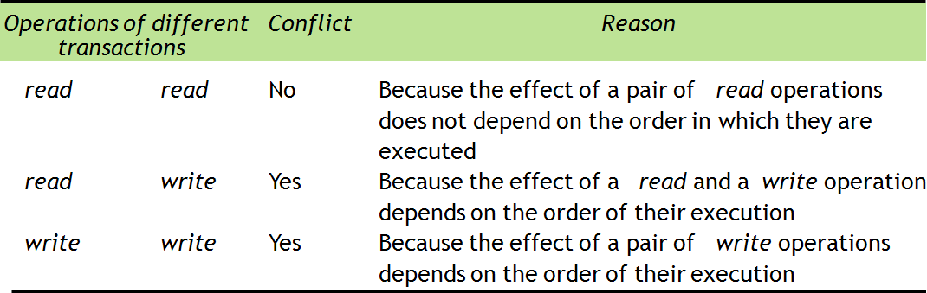
Read and Write Conflicts
Notes:
Hanna 6-7

Slide 32
Three Methods For CC Control
There are many methods for concurrency control
The main methods are:
Locks
Optimistic concurrency control
Timestamp ordering

Slide 33
Locks
Locks are used to order transactions that access the same objects according to the order of arrival of their operations at the objects.
Mechanism for enforcing limits on access to the object
If the access to the object is locked other users have to wait until it’s unlocked

Slide 34
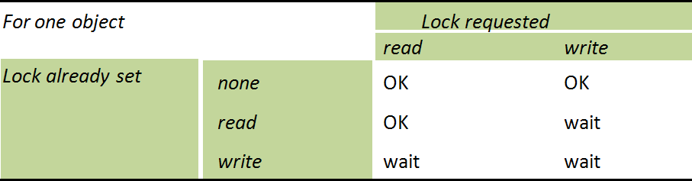
Lock Compability

Slide 35
A problem with lock
The use of locks can lead to deadlocks
Ex: Two transactions are waiting and each is dependent on the other to release a lock so it can resume
Held by
Waits for
A
T
U
T
U
Waits for
B
Held by
Notes:
Deadlock prevention s 540
Liv 8-10

Slide 36
Optimistic concurrency control
Optimistic concurrency control (OCC) is based on the assumption that two transactions won’t occur at the same time
OCC is generally used in environments with low data contention
OCC Phases
Begin
Working phase
Validation phase
Update phase

Slide 37
Locking Protocols
Can use the two-phase locking protocol in a distributed environment by changing how the lock manager is implemented
Non-Replicated scheme – each site maintains a local lock manager which administers lock and unlock requests for those data items that are stored in that site
Simple implementation involves two message transfers for handling lock requests, and one message transfer for handling unlock requests
Deadlock handling is more complex

Slide 38
Single-Coordinator Approach
A single lock manager resides in a single chosen site, all lock and unlock requests are made at that site
Simple implementation
Simple deadlock handling
Possibility of bottleneck
Vulnerable to loss of concurrency controller if single site fails
Multiple-coordinator approach distributes lock-manager function over several sites

Slide 39
Majority Protocol
Local lock manager at each site administers lock and unlock requests for data items stored at that site.
When a transaction wishes to lock an un replicated data item Q residing at site S_{i}, a message is sent to S_{i} ‘s lock manager.
If Q is locked in an incompatible mode, then the request is delayed until it can be granted.
When the lock request can be granted, the lock manager sends a message back to the initiator indicating that the lock request has been granted.

Slide 40
Majority Protocol (Cont.)
In case of replicated data
If Q is replicated at n sites, then a lock request message must be sent to more than half of the n sites in which Q is stored.
The transaction does not operate on Q until it has obtained a lock on a majority of the replicas of Q.
When writing the data item, transaction performs writes on all replicas.
Benefit
Can be used even when some sites are unavailable
Drawback
Requires many messages for handling lock requests and for handling unlock requests.
Potential of deadlock.

Slide 41
Biased Protocol
Similar to majority protocol, but requests for shared locks have priority over requests for exclusive locks
Less overhead on read operations than in majority protocol; but has additional overhead on writes
Like majority protocol, deadlock handling is complex

Slide 42
Primary Copy
One of the sites at which a replica resides is designated as the primary site
Request to lock a data item is made at the primary site of that data item
Concurrency control for replicated data handled in a manner similar to that of un-replicated data
Simple implementation, but if primary site fails, the data item is unavailable, even though other sites may have a replica

Slide 43
Time Stamp
Whenever a transaction starts, it is given a timestamp
The timestamp tells in which order, the transactions are supposed to be applied in
The transaction with the earliest timestamp is executed first
Every object in the system has a read timestamp and a write timestamp
Notes:
Stina 15-17

Slide 44
Time-stamping in Distributed Sys
Generate unique timestamps in distributed scheme:
Each site generates a unique local timestamp
The global unique timestamp is obtained by concatenation of the unique local timestamp with the unique site identifier
Use a logical clock defined within each site to ensure the fair generation of timestamps

Slide 45
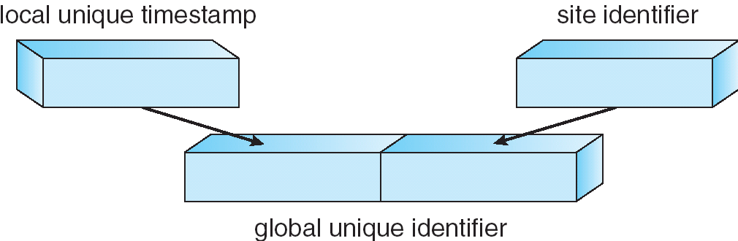
Generation of Unique Timestamps

Slide 46
Deadlock Prevention
Resource-ordering deadlock-prevention – define a global ordering among the system resources
Assign a unique number to all system resources
A process may request a resource with unique number i only if it is not holding a resource with a unique number greater than i
Simple to implement; requires little overhead
Banker’s algorithm – designate one of the processes in the system as the process that maintains the information necessary to carry out the Banker’s algorithm
Also implemented easily, but may require too much overhead

Slide 47
Timestamped Deadlock-Prevention Scheme
Each process P_{i} is assigned a unique priority number
Priority numbers are used to decide whether a process P_{i} should wait for a process P_{j}; otherwise P_{i} is rolled back
The scheme prevents deadlocks
For every edge P_{i} → P_{j} in the wait-for graph, P_{i} has a higher priority than P_{j}
Thus a cycle cannot exist

Slide 48
Wait-Die Scheme
Based on a non-preemptive technique
If P_{i} requests a resource currently held by P_{j}, P_{i} is allowed to wait only if it has a smaller timestamp than does P_{j} (P_{i} is older than P_{j})
Otherwise, P_{i} is rolled back (dies)
Example: Suppose that processes P₁, P₂, and P₃ have timestamps 5, 10, and 15 respectively
if P₁ request a resource held by P₂, then P₁ will wait
If P₃ requests a resource held by P₂, then P₃ will be rolled back

Slide 49
Would-Wait Scheme
Based on a preemptive technique; counterpart to the wait-die system
If P_{i} requests a resource currently held by P_{j}, P_{i} is allowed to wait only if it has a larger timestamp than does P_{j} (P_{i} is younger than P_{j}). Otherwise P_{j} is rolled back (P_{j} is wounded by P_{i})
Example: Suppose that processes P₁, P_{2,} and P₃ have timestamps 5, 10, and 15 respectively
If P₁ requests a resource held by P₂, then the resource will be preempted from P₂ and P₂ will be rolled back
If P₃ requests a resource held by P₂, then P₃ will wait

Slide 50
Deadlock Detection
Use wait-for graphs
Local wait-for graphs at each local site. The nodes of the graph correspond to all the processes that are currently either holding or requesting any of the resources local to that site
May also use a global wait-for graph. This graph is the union of all local wait-for graphs.

Slide 51
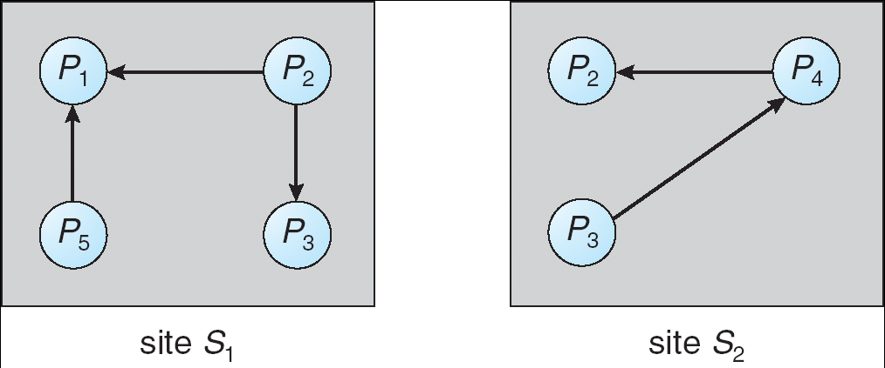
Two Local Wait-For Graphs

Slide 52
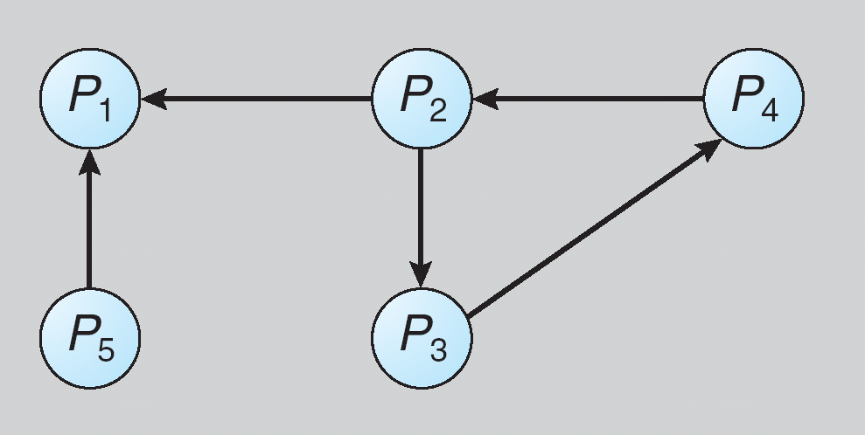
Global Wait-For Graph

Slide 53
Deadlock Detection – Centralized Approach
Each site keeps a local wait-for graph
A global wait-for graph is maintained in a single coordination process.
There are three different options (points in time) when the wait-for graph may be constructed:
1. Whenever a new edge is inserted or removed in one of the local wait-for graphs
2. Periodically, when a number of changes have occurred in a wait-for graph
3. Whenever the coordinator needs to invoke the cycle-detection algorithm
Unnecessary rollbacks may occur as a result of false cycles

Slide 54
The Detection Algorithm
1. The controller sends an initiating message to each site in the system
2. On receiving this message, a site sends its local wait-for graph to the controller/coordinator
3. When the controller has received a reply from each site, it constructs a graph as follows:
(a) The constructed graph contains a vertex for every process in the system
(b) The graph has an edge Pi → Pj if and only if
there is an edge Pi → Pj in one of the wait-for graphs, or
an edge Pi → Pj with some label TS appears in more than one wait-for graph
If the constructed graph contains a cycle ⇒ deadlock

Slide 55
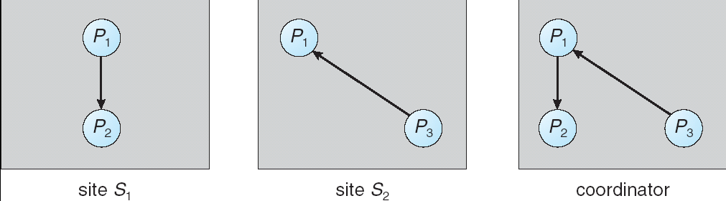
Local and Global Wait-For Graphs

Slide 56
Fully Distributed Approach
All controllers/sites equally share the responsibility for detecting deadlock
Every site constructs a wait-for graph that represents a part of the total graph
We add one additional node P_{ex} to each local wait-for graph
If a local wait-for graph contains a cycle that does not involve node P_{ex}, then the system is in a deadlock state
A cycle involving P_{ex} implies the possibility of a deadlock
To ascertain whether a deadlock does exist, a distributed deadlock-detection algorithm must be invoked

Slide 57
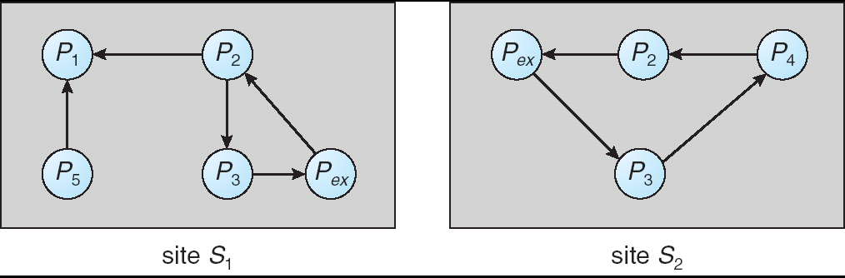
Augmented Local Wait-For Graphs

Slide 58
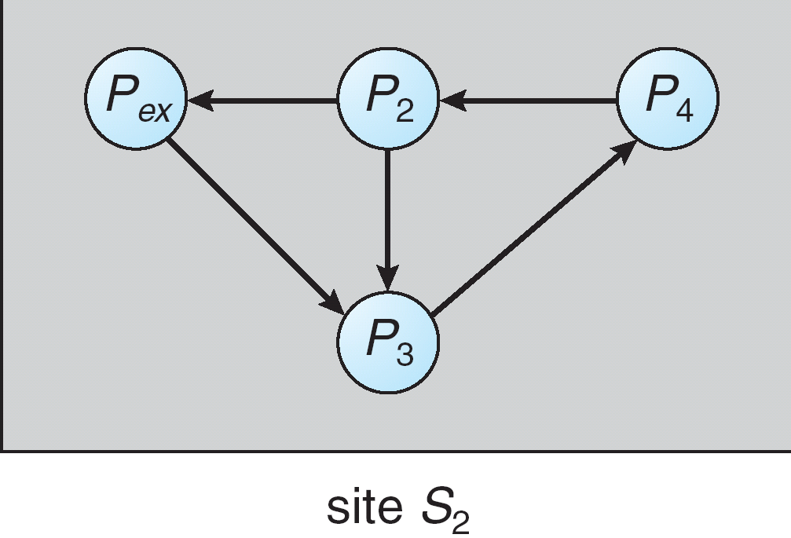
Augmented Local Wait-For Graph in Site S2

Slide 59
Election Algorithms
If the coordinator process fails due to failure of site
The algorithm which determine where a new copy of the coordinator should be restarted
Assume that a unique priority number is associated with each active process in the system, and assume that the priority number of process P_{i} is i
Assume a one-to-one correspondence between processes and sites
The coordinator is always the process with the largest priority number. When a coordinator fails, the algorithm must elect that active process with the largest priority number

Slide 60
Bully Algorithm
Two algorithms, the bully algorithm and a ring algorithm, can be used to elect a new coordinator in case of failures
Bully Algo Applicable to systems where every process can send a message to every other process in the system
If process P_{i} sends a request that is not answered by the coordinator within a time interval T, assume that the coordinator has failed; P_{i} tries to elect itself as the new coordinator
P_{i} sends an election message to every process with a higher priority number, P_{i} then waits for any of these processes to answer within T

Slide 61
Bully Algorithm (Cont.)
If no response within T, it assume that all processes with numbers greater than i have failed; P_{i} elects itself the new coordinator
If answer is received, P_{i} begins time interval T´, waiting to receive a message that a process with a higher priority number has been elected
If no message is sent within T´, assume the process with a higher number has failed; P_{i} should restart the algorithm

Slide 62
Bully Algorithm (Cont.)
If P_{i} is not the coordinator, then, at any time during execution, P_{i} may receive one of the following two messages from process P_{j}
P_{j} is the new coordinator (j > i). P_{i}, in turn, records this information
P_{j} started an election (j is less than i). P_{i}, sends a response to P_{j} and begins its own election algorithm, provided that Pi has not already initiated such an election
After a failed process recovers, it immediately begins execution of the same algorithm
If there are no active processes with higher numbers
The recovered process forces all processes with lower number to let it become the coordinator process, even if there is currently an active coordinator with a lower number

Slide 63
Ring Algorithm
Applicable to systems organized as a ring (logically or physically)
Assumes that the links are unidirectional, and that processes send their messages to their right neighbors
Each process maintains an active list, consisting of all the priority numbers of all active processes in the system when the algorithm ends
If process Pi detects a coordinator failure, It creates a new active list that is initially empty. It then sends a message elect(i) to its right neighbor, and adds the number i to its active list

Slide 64
Ring Algorithm (Cont.)
If P_{i} receives a message elect(j) from the process on the left, it must respond in one of three ways:
If this is the first elect message it has seen or sent, P_{i} creates a new active list with the numbers i and j
It then sends the message elect(i), followed by the message elect(j)
If i ≠ j, then the active list for P_{i} now contains the numbers of all the active processes in the system
P_{i} can now determine the largest number in the active list to identify the new coordinator process
If i = j, then P_{i} receives the message elect(i)
The active list for P_{i} contains all the active processes in the system
P_{i} can now determine the new coordinator process.

Slide 65
Reaching Agreement
There are applications where a set of processes wish to agree on a common “value”
Such agreement may not take place due to:
Faulty communication medium
Faulty processes
Processes may send garbled or incorrect messages to other processes
A subset of the processes may collaborate with each other in an attempt to defeat the scheme

Slide 66
Faulty Communications
Process P_{i} at site A, has sent a message to process P_{j} at site B; to proceed, P_{i} needs to know if P_{j} has received the message
Detect failures using a time-out scheme
When P_{i} sends out a message, it also specifies a time interval during which it is willing to wait for an acknowledgment message from P_{j}
When P_{j} receives the message, it immediately sends an acknowledgment to P_{i}
If P_{i} receives the acknowledgment message within the specified time interval, it concludes that P_{j} has received its message
If a time-out occurs, P_{i} needs to retransmit its message and wait for an acknowledgment
Continue until P_{i} either receives an acknowledgment, or is notified by the system that B is down

Slide 67
Faulty Communications (Cont.)
Suppose that P_{j} also needs to know that P_{i} has received its acknowledgment message, in order to decide on how to proceed
In the presence of failure, it is not possible to accomplish this task
It is not possible in a distributed environment for processes P_{i} and P_{j} to agree completely on their respective states

Slide 68
The End

